Slide 1
algorithms
ITCSC Winter School 2010
and randomness
Andrej Bogdanov
The Chinese University of Hong Kong

Slide 2
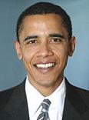
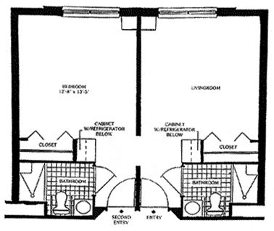
planning a good party
Suppose these guests show up at your house:
red room
green room
How will you fit them into your 2-room apartment?

Slide 3
the problem
Some of these guys really hate each other!

Slide 4
the problem
green room
red room
To reduce the danger, you set them up like this

Slide 5
maximum cut
Divide the vertices into two sets (a cut) so that
you split as many edges as possible

Slide 6
maximum cut
This cut splits all but two of the edges
Is it the best possible cut?

Slide 7
maximum cut
No matter which split you choose,
you have to cut through two triangles

Slide 8
maximum cut
Question:
Given a graph, find a cut that splits as many edges as possible
Problem:
Sometimes, no matter what you do,
you can hardly cut more than 50%!
green
red
complete graph on n vertices
(n/2)²
1
n
best cut =
n
=
(
)
2
n− 1
2

Slide 9
maximum cut algorithm
Challenge:
Design an algorithm that always splits
at least 50% of the edges
Method:
For each vertex, decide at random if it is red or green
If fewer than half the edges are cut,
repeat the experiment

Slide 10
Algorithm analysis
Algorithm finishes in O(m) trials w.p. 99%
m = number of edges
Analysis:
First we analyze one trial:
X = number of edges that are not split
{
e
0, if
X_{e} =
e
e
1, if or
E[X] = Σ_{edge e}E[X_{e}] = Σ_{edge e}Pr[X_{e} = 1] = m/2

Slide 11
Algorithm analysis
Algorithm finishes in O(m) trials w.p. 99%
m = number of edges
Analysis:
E[X] = m/2
Pr [X >m/2]
= Pr[X≥ m/2 + 1/2]
= Pr[X≥ (1 + 1/m)m/2]
1
≤
1 + 1/m
= 1 – 1/2m

Slide 12
Algorithm analysis
Algorithm finishes in O(m) trials w.p. 99%
m = number of edges
Analysis:
In each trial, more than m/2 edges are cut
with probability at most 1 − 1/2m
After 20m trials, the probability that >m/2 edges are cut in all trials is at most
(1 – 1/2m)^{20m}< 1%

Slide 13
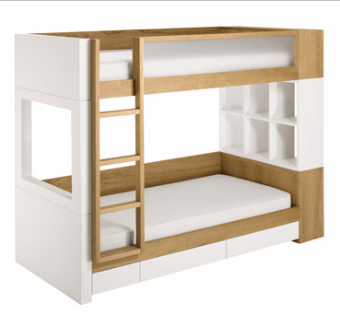
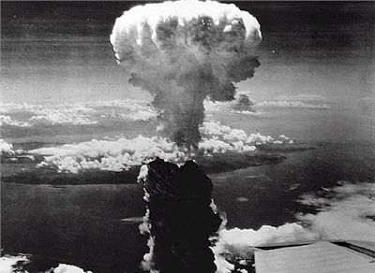
when randomness is problematic
Our algorithm works correctly 99% of the time…
…but sometimes 99% is not good enough!

Slide 14
eliminating randomness
99% correct
algorithm
100% correct
algorithm
We will show two ways to do this:
(1) By iterative removal of randomness
(2) Using a pseudorandom source

Slide 15
iterative removal of randomness
Instead of dividing up the vertices in one step, we do it one at a time
In step k, we decide if kth vertex is green or red without using randomness
At every step we maintain the following invariant:
If rest of the vertices were divided up at random, we expect to split ≥ 50% of the edges

Slide 16
iterative removal of randomness
Invariant:
Before we begin, we know invariant is true
How can we preserve the invariant at every step? Let’s start with the first step
If rest of the vertices were divided up at random, we expect to split ≥ 50% of the edges

Slide 17
iterative removal of randomness
vertices = {v₁, v₂, …, v_{n}}
v₂
v₃
X = number of edges that are not split
v₁
v₄
E[X] = m/2 = 5½
but actually:
v₆
v₅
E[X | v₁ = ] = m/2
Should we make v₁
red or green?
E[X | v₁ = ] = m/2
It doesn’t make a difference, so let’s make v₁ red

Slide 18
iterative removal of randomness
v₂
v₃
E[X | v₁ = ] = m/2 = 5½
v₁
v₄
E[X| v₁ = ]
= ½ E[X | v₂ = , v₁ = ]
+ ½ E[X | v₂ = , v₁ = ]
v₆
v₅
at least one of them
must be≤m/2
Should we make v₂
red or green?
E[X | v₂ = , v₁ = ] = 6
E[X | v₂ = , v₁ = ] = 5
…so it is better for us to make v₂ green

Slide 19
iterative removal of randomness
v₂
v₃
Continuing in this way, we
end up with a cut that splits
at least half the edges
v₁
v₄
To calculate an expression like:
v₆
v₅
E[X | v₃ = , v₂ = , v₁ = ]
we add the contributions of all the edges:
½
1
0
½
1
½

Slide 20
simplifying the algorithm
If you look into it more carefully, you notice that
So using randomness as a design tool, we ended up with a deterministic, greedy algorithm for splitting:
The color chosen for v_{k} by the algorithm
is the one that maximizes the number of
split edges from v_{k} to {v₁,…, v_{k-1}}
The greedy algorithm always splits at least
half of the edges

Slide 21
randomized versus greedy
Randomized splitting:
Greedy splitting:
For t = 1 to 20m
For k = 1 to n
For each vertex v_{k}:
Choose color for v_{k} that
maximizes number of
edges to {v₁,…, v_{k-1}}
WINNER!
Randomly assign or
If more than half edges
are split, return split.
Return split.
Otherwise, fail.
50%
edges split
50%
99%
chance of success
100%
O(m²)
running time
O(m)

Slide 22
does randomness help
Is it always the case that deterministic algorithms beat randomized algorithms?
No, sometimes randomized algorithms can be faster
However, it is believed that in all cases
99% correct
algorithm
runs in time t
100% correct algorithm
runs in time t^{c}

Slide 23
deterministic max-cut via “pseudorandom sources”
To illustrate how this is done, let’s go back to our random algorithm for max-cut:
Now, instead of coloring independently, we’ll do it in a special way:
For each vertex v_{k}:
Assign or independently at random
v₁ = 001
v₄ = 100
First, we represent each vertex
by a binary string of length log n
v₂ = 010
v₅ = 101
v₃ = 011
v₆ = 110

Slide 24
deterministic max-cut via “pseudorandom sources”
Now we change the coloring like this:
Choose a random log n bit string z
For each vertex v_{k}:
Assign if <v_{k}, z> = 0
Assign if <v_{k}, z> = 1
<v_{k}, z> = v_{k,1}⋅z₁ + … + v_{k, log n}⋅z_{logn} mod 2
for example:
<101, 011> = 1⋅0 + 0⋅1 + 1⋅1 = 0 + 0 + 1 = 1

Slide 25
deterministic max-cut via “pseudorandom sources”
Analysis:
X = number of edges that are not split
{
e
1, if
X_{e} =
e
e
0, if or
E[X] = Σ_{edge e}E[X_{e}] = Σ_{edge e}Pr[X_{e} = 1]
e
but what is Pr[X_{e} = 1]?
v_{a}
v_{b}
Pr[X_{e} = 1]
= Pr[col(v_{a}) ≠ col(v_{b})]
= Pr_{z}[<v_{a}, z> ≠ <v_{b}, z>]

Slide 26
deterministic max-cut via “pseudorandom sources”
Analysis:
Pr[X_{e} = 1] = Pr_{z}[<v_{a}, z> ≠ <v_{b}, z>]
let’s look at the binary strings for v_{a} and v_{b}
v_{a} = 0011001
v_{a}’ = 0011001
v_{b} = 0010101
v_{b}’ = 0010101
they must differ
in some position i
z’ = z without ith bit
we take out position ifrom v_{a}, v_{b}, and z
<v_{a}, z> = <v_{a}’, z’> + 1⋅z_{i}
<v_{b}, z> = <v_{b}’, z’> + 0⋅z_{i}

Slide 27
deterministic max-cut via “pseudorandom sources”
Analysis:
Pr[X_{e} = 1] = Pr_{z}[<v_{a}, z> ≠ <v_{b}, z>]
<v_{a}, z> = <v_{a}’, z’> + 1⋅z_{i}
<v_{b}, z> = <v_{b}’, z’> + 0⋅z_{i}
Pr_{z}[<v_{a}, z> ≠ <v_{b}, z>]
= Pr_{z}[z_{i} ≠ <v_{a}’, z’> + <v_{b}’, z’>]
= ½
because z_{i} is independent of z’
so E[X] = Σ_{edge e}Pr[X_{e} = 1] = m/2

Slide 28
a third algorithm for max-cut
Derandomized max-cut algorithm:
For all possible log n bit strings z:
Choose a random log n bit string z
For each vertex v_{k}:
Assign if <v_{k}, z> = 0
Assign if <v_{k}, z> = 1
If more than half edges are split, return.
We showed that E[X] = m/2 for a randomz
so then X = m/2 for at least one choice ofz

Slide 29
a third algorithm for max-cut
Derandomized max-cut algorithm:
For all possible log n bit strings z:
Choose a random log n bit string z
For each vertex v_{k}:
Assign if <v_{k}, z> = 0
Assign if <v_{k}, z> = 1
If more than half edges are split, return.
This algorithm finds a good split w.p. ≥ 50%
Its running time is: 2^{logn}m =O(nm)

Slide 30
generic derandomization
Recall how we designed this deterministic algorithm:
graph G
random colors
v₁
v₂
…
v_{n}
is split ≥ 50%?

Slide 31
generic derandomization
Recall how we designed this deterministic algorithm:
graph G
random z
col(v_{k}) = <v_{k}, z>
is split ≥ 50%?

Slide 32
generic derandomization
Recall how we designed this deterministic algorithm:
graph G
all possible z
col(v_{k}) = <v_{k}, z>
is split > 50%?

Slide 33
generic derandomization
The design happened in two steps:
input
randomness
reducer
randomized
algorithm

Slide 34
pseudorandom generators
The design of the “randomness reducer” is independent of the randomized algorithm!
Its job is to take k = log n random bits and turn them into n “random-looking” bits
Such a device is called a pseudorandom generator
pseudorandom
generator
randomized
algorithm
Random!

Slide 35
pseudorandom generators
It is believed that there is a pseudorandom generator that works for all algorithms
Using the trick that worked for max-cut, we can turn any randomized algorithm into a deterministic one
99% correct
algorithm
runs in time t
100% correct algorithm
runs in time t^{c}

